Slide 1
Permian Basin West Texas & New Mexico Depositional Settings & Facies Hierarchies
Christopher G. St.C. Kendall
803 – 312 1569
kendall@geol.sc.edu

Slide 2
Permian Basin West Texas and New Mexico

Slide 3
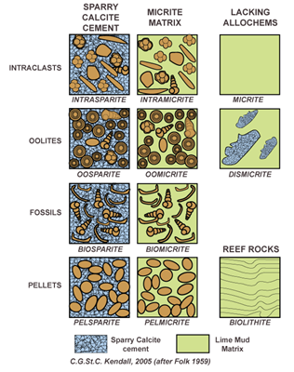
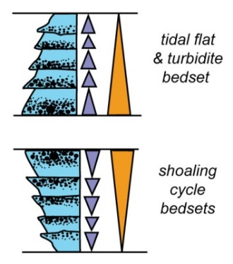
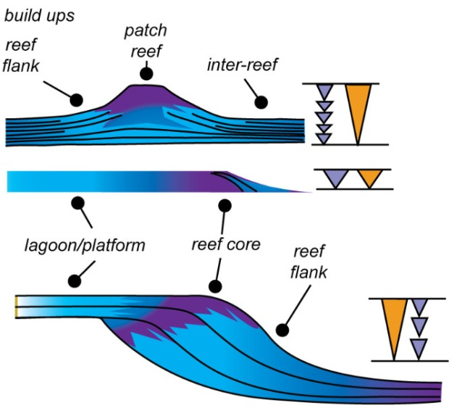
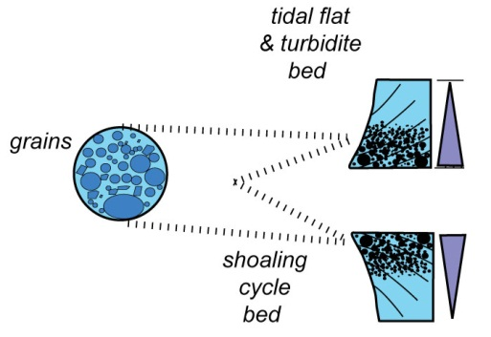
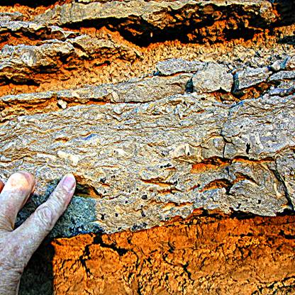
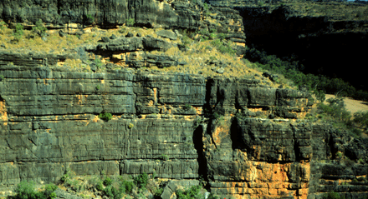
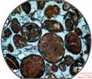
Carbonate Platform Architectural Elements
ALLOCHEMS
CEMENTATION
& DIAGENESIS
,
SEDIMENTARY
STRUCTURES
FAUNA
GRAINS
STACKED BED CYCLES
CYCLES OF
BEDS
REEFS
PROGRADING MARGIN
HST MARGIN
COMPLEX
MARGIN
COMPLEX
PROGRADING MARGIN
SHELF
MARGIN
COMPLEX
SHELF
COMPLEX
ONLAPPING MARGIN
PROGRADING MARGIN

Slide 4
Permian Basin Carbonate Hierarchy - Units
SHELF COMPLEX – Mix of shelf, shelf margin & adjacent basin facies evolving in response to complete & complex cycles of changing base level & paleogeography
MARGIN COMPLEX – Shelf, shelf margin & adjacent basin facies evolving in response to a cycle in changing base level
STACKED CYCLES OF BEDS – Vertical character of beds from varying depositional settings
BEDDING – Internal character including lithology, geometry, sedimentary structures, and fauna
ALLOCHEMS – Lthological components, their cementation & diagenesis

Slide 5
Lecture Conclusions
Shelf has wide spread continuous sheets that tend to shoal up
Outer shelf:- heterogeneous carbonates with mix of linear bodies parallel to basin & perpendicular to it! Local build up lenses.
Inner shelf:- dominated by mud prone sheets with evaporites & or clastic channels and sheets
Margin: Massive and heterogeneous, most porous but least prone to seal
Down slope sheets that thin down slope & may be grain prone in distal portions
Basinal couplets of mud and silt from mix of pelagic and shelf sources
Evaporite couplet from basin isolation

Slide 6
Carbonate Setting & Facies Hierarchies
The sequence stratigraphic framework is used to:
Interpret carbonate depositional settings
Predict facies and geometric hierarchies of potential carbonate plays & reservoir models.
Through geologic time carbonate depositional systems have common critical elements in sedimentary character determined by the processes operating from the deep basin to inner updip shelf.
Over simple relationships are used to predict potential carbonate plays & reservoir models.

Slide 7
Critical Criteria
Hydrocarbon exploration and production depend on prediction of porosity and permeability in conjunction with up dip structural position
Carbonate depositional setting and facies hierarchies are key to predicting porosity and permeability and so hydrocarbon distribution
Sequence stratigraphy of carbonates and evaporites provide the framework this reservoir characterization
This lecture provides the sequence stratigraphic controls on carbonate evaporite stratigraphy

Slide 8
Sequence Stratigraphic Framework
Framework of erosional & flooding surfaces formed by base-level change
Interpretation of carbonate depositional systems, geometric architecture and facies bound to a sequence stratigraphic framework provides:
Prediction of extent and character of facies
Chronology of carbonate facies geometries
Applies no matter geotectonic setting & physical, chemical and biological conditions of depositional setting

Slide 9
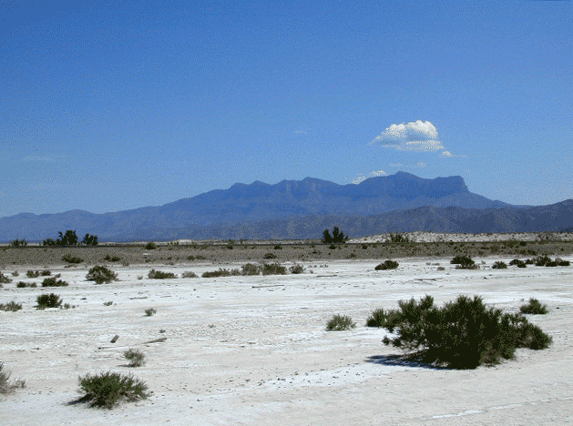
Guadalupe Mtns - West Face – Salt Flats
Capitan Reef Slope
Salt Flat
Kendall Photo

Slide 10
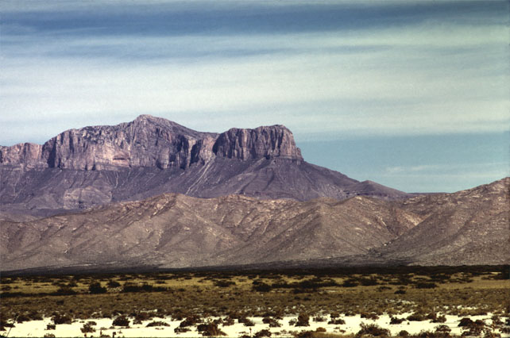
Guadalupe Mtns - West Face
Reef &
Fore Reef
Basinal Clastic
Turbidites
Kendall Photo

Slide 11
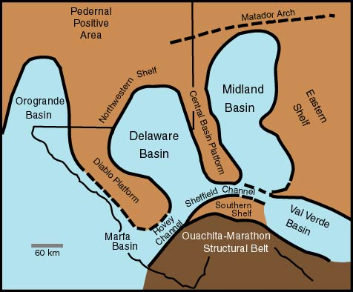
Permian Basin West Texas and New Mexico
Scholle,1999

Slide 12
Guadalupe Mts and Permian Basin Settings
Open
Shelf
Sabkha
Sediments
Basin
Margin
Carbonates
Basin Slope Lst
& Clastic Cycles
Thin Basinward
Thin Basinal
Clastics & Lst
Kendall Photo

Slide 13
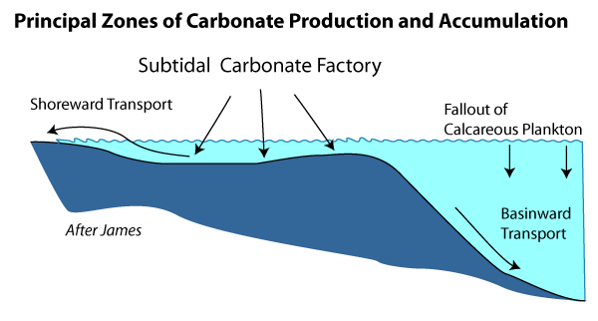
Principle Belts of Carbonate Accumulation
MARGIN
RESTRICTED
OPEN MARINE
SHELF
SLOPE
BASIN

Slide 14
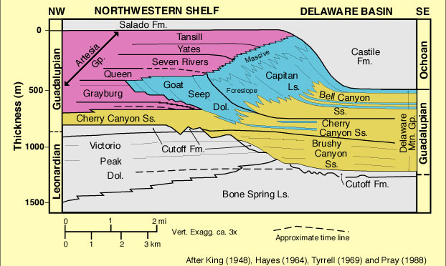
Delaware Basin Stratigraphy

Slide 15
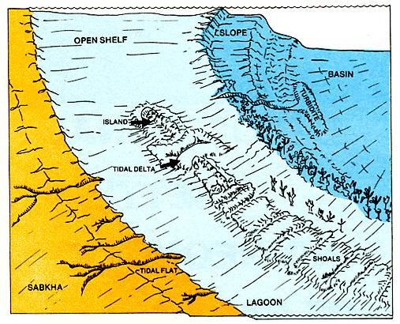
Carbonate Depositional Setting Physiography

Slide 16
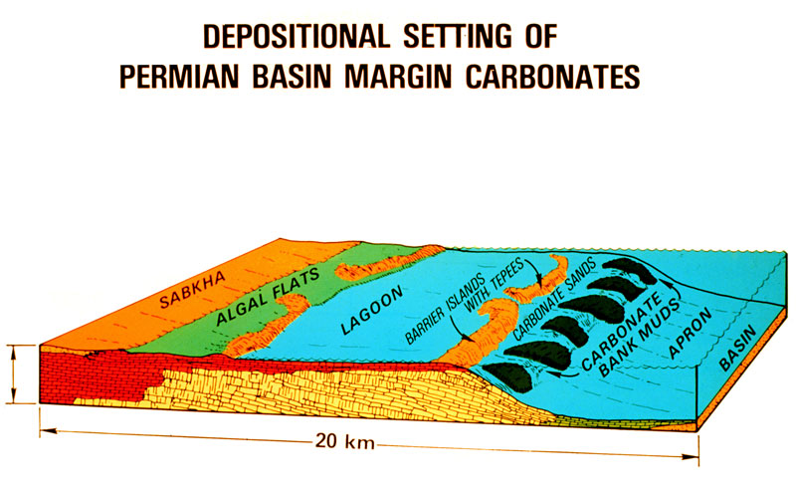
Depositional Settings of Permian Basin

Slide 17
Depositional Settings of Permian Basin
Open Marine Shelf
Restricted
Tidal Flats
& Lagoon
Margin
Slope
Basin
Fill

Slide 18
Depositional Settings of Permian Basin
Shelf
Outer normal marine
Inner restricted
Shelf margin crest
Margin slope
Basin

Slide 19
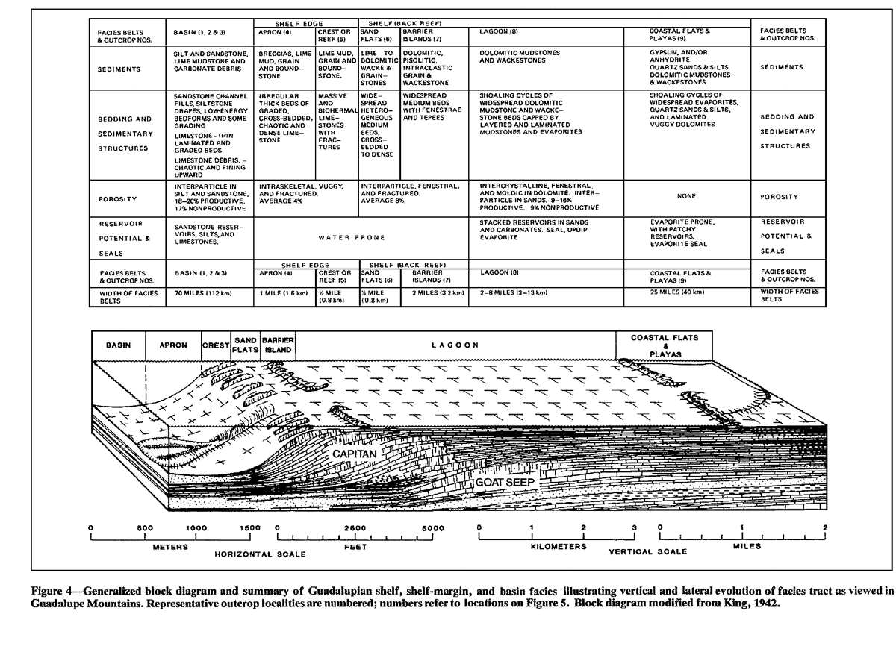
Depositional Settings of Permian Basin

Slide 20
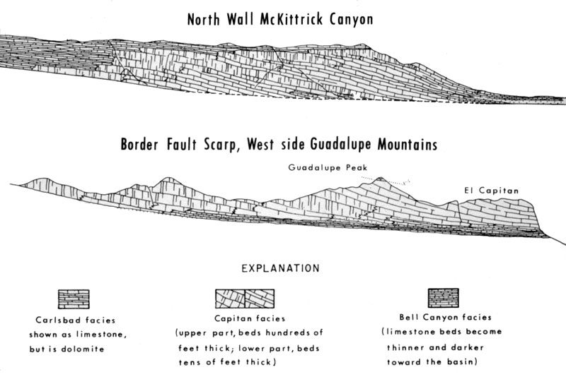
Depositional Settings of Permian Basin

Slide 21
Depositional Settings of Permian Basin

Slide 22
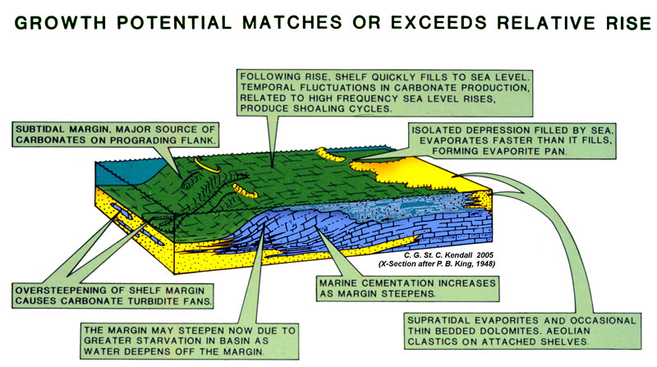
Depositional Settings of Permian Basin

Slide 23
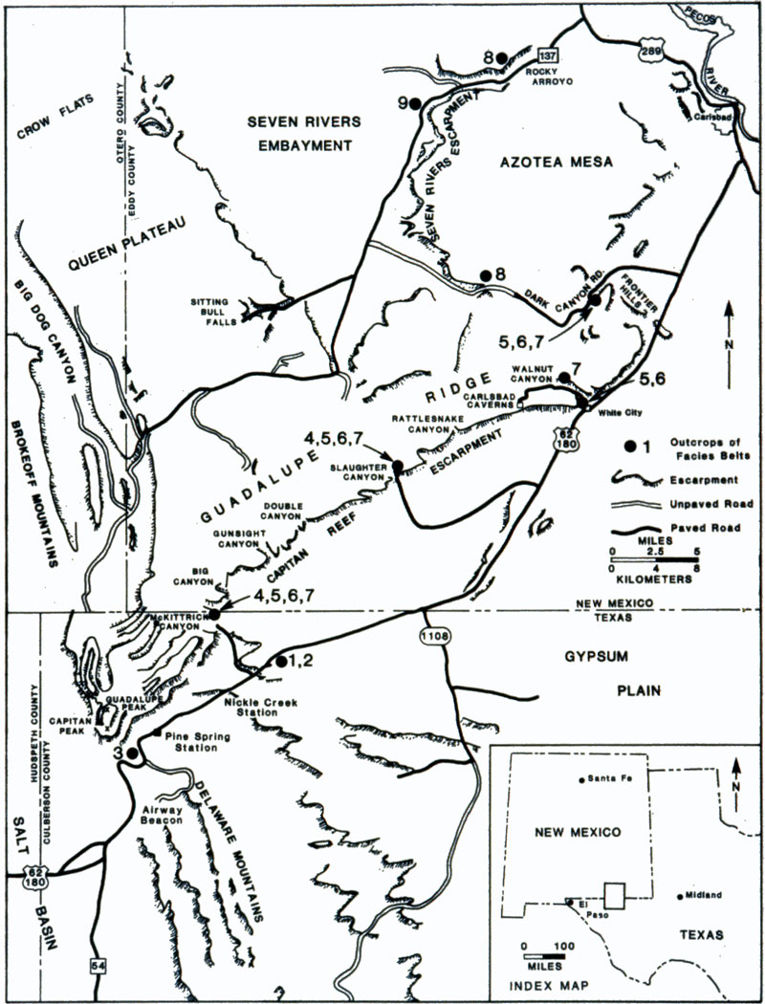
Permian Basin Field Stops
Sitting Bull
Falls
Carlsbad
Caverns
McKittrick Cayon
Rader Conglomerate
View of
Guadalupe
Mts. from
Salt
Flat
Turbidite
Fans of
The Delaware
Mountain
Group

Slide 24
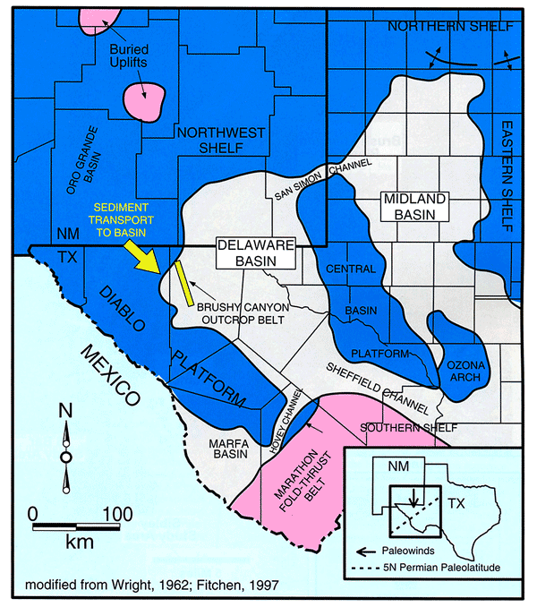
Depositional Settings of Permian Basin
Brushy Canyon Sands

Slide 25
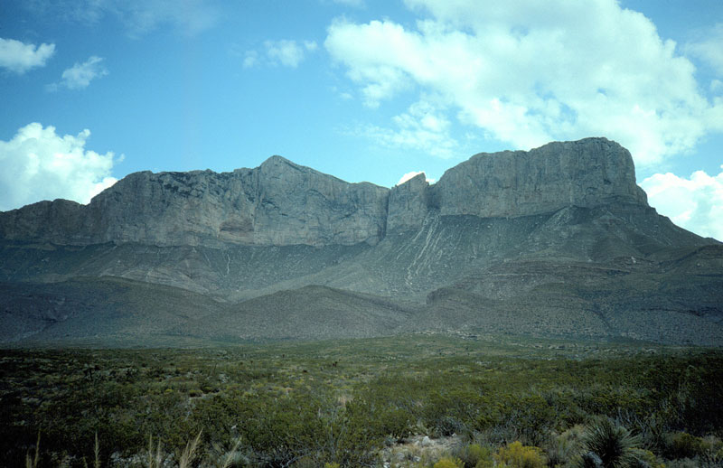
Permian Basin – Guadalupe Mtns – West Face
Capitan Reef Slope
Victorio Peak Margin Slope
Kendall Photo

Slide 26
Depositional Settings of Permian Basin
Permian
Clastic Basin Fill
Carbonates
Evaporites

Slide 27
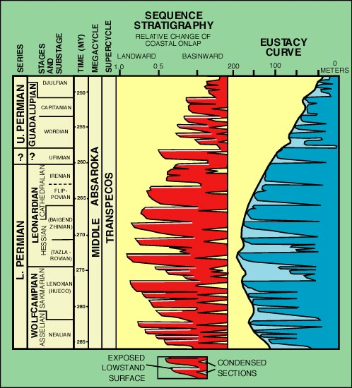
Sequence Stratigraphy of Permian Basin
EUSTASY
After
Ross & Ross, 1988
-
Scholle, 1999

Slide 28
Sequence Stratigraphy of Permian Basin

Slide 29
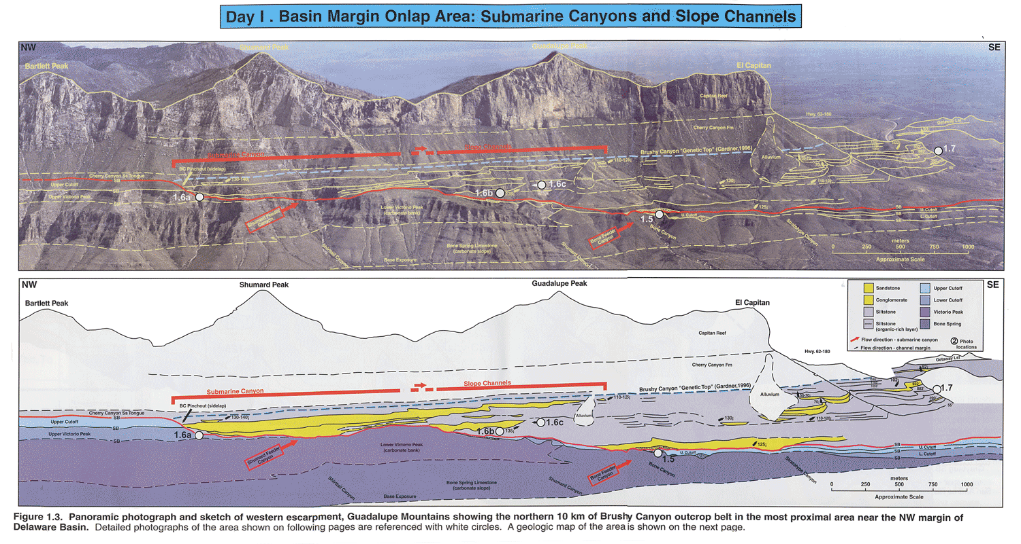
Sequence Stratigraphy of Permian Basin
After Tinker 1998

Slide 30
Permian Basin – Guadalupe Mtns – West Face

Slide 31
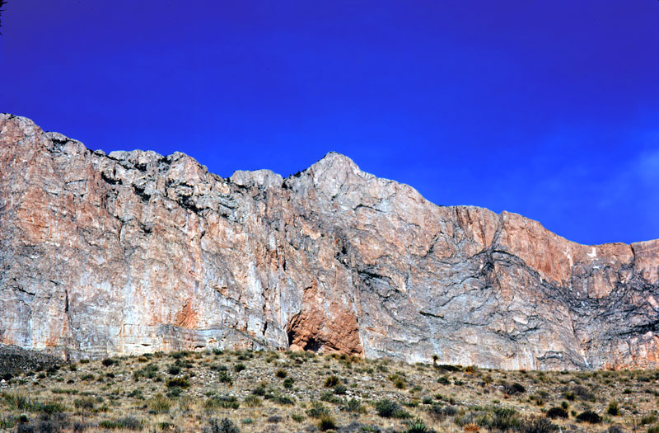
Permian Basin – Guadalupe Mtns – West Face
Capitan Reef
Capitan Reef Slope
Kendall Photo

Slide 32
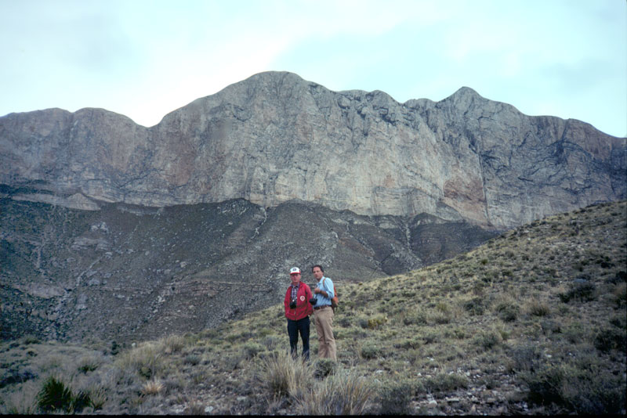
Permian Basin – Guadalupe Mtns – West Face
Capitan Reef
Capitan Reef Slope
Kendall Photo

Slide 33
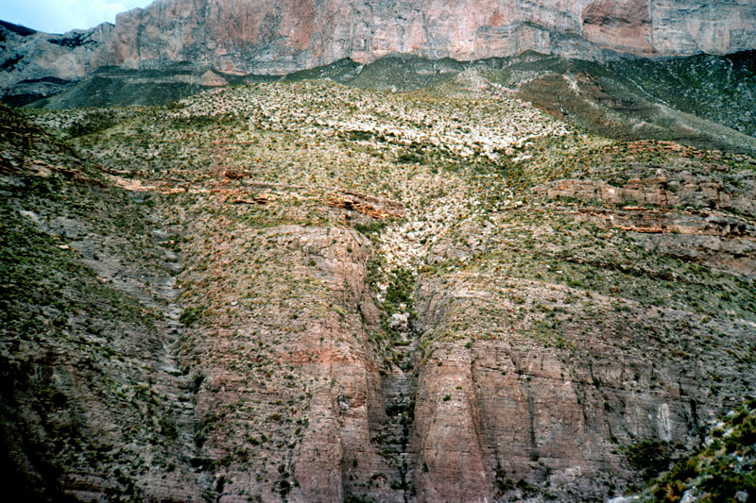
West Face & Victorio Peak
Cherry Canyon Sands
Cut Off Channel
Victorio Peak Ramp Slope
Kendall Photo

Slide 34
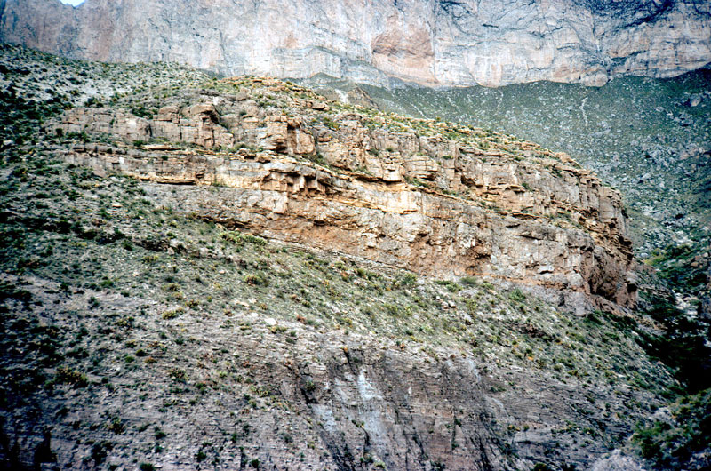
West Face – Victorio Peak
Cut Off Channel
Victorio Peak Ramp Slope
Kendall Photo

Slide 35
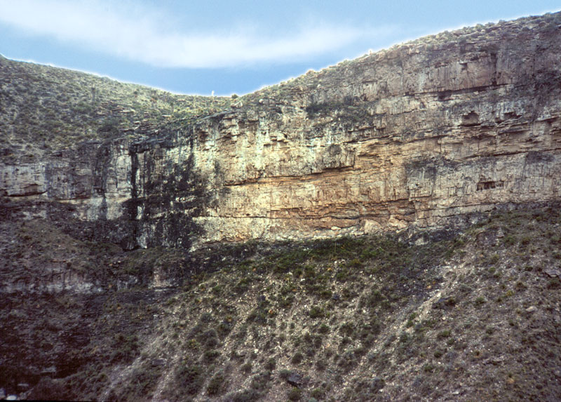
West Face – Cut Off
Mega Breccia with Sand
Kendall Photo

Slide 36
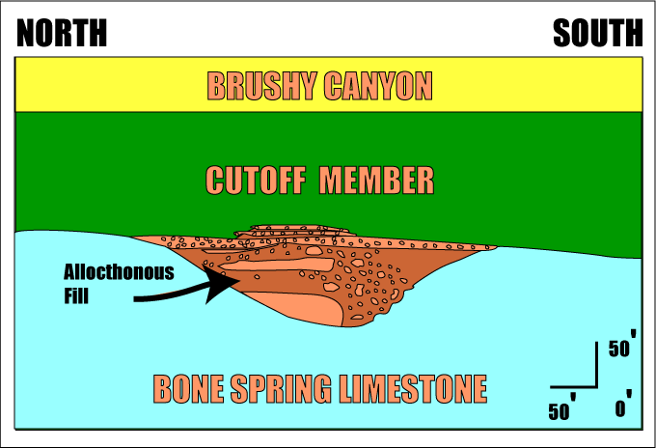
West Face – Cut Off

Slide 37
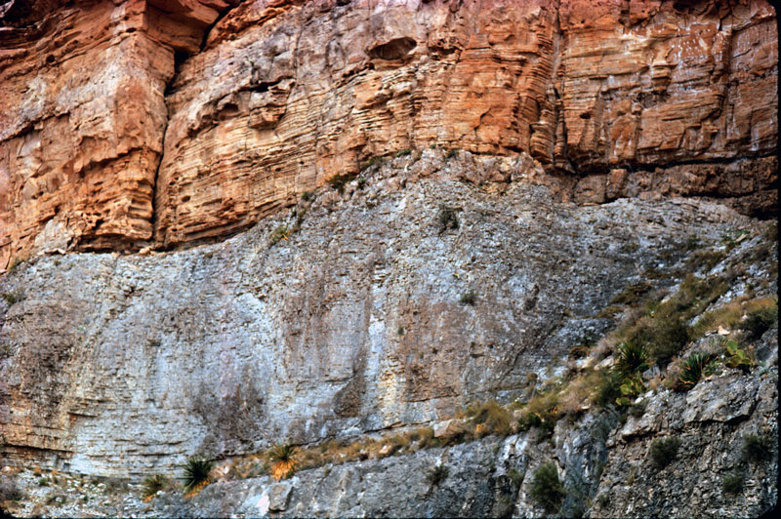
Cherry Canyon Formation
Mega Breccia with Sand
Kendall Photo

Slide 38
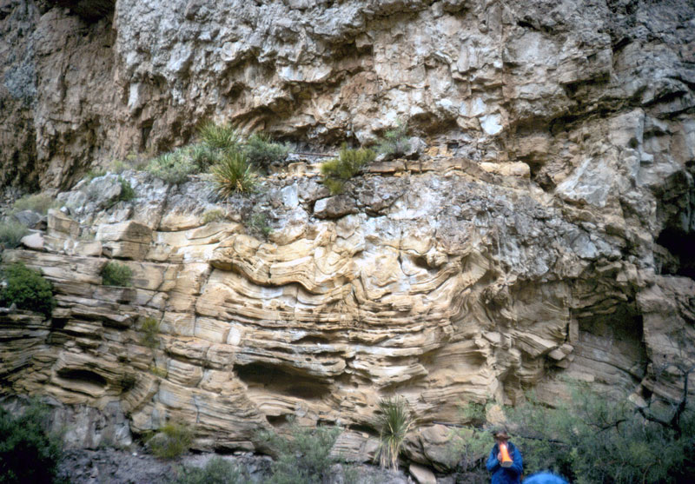
West Face – Cut Off
Displaced Megabreccia
Brushy Canyon Sands
Kendall Photo

Slide 39
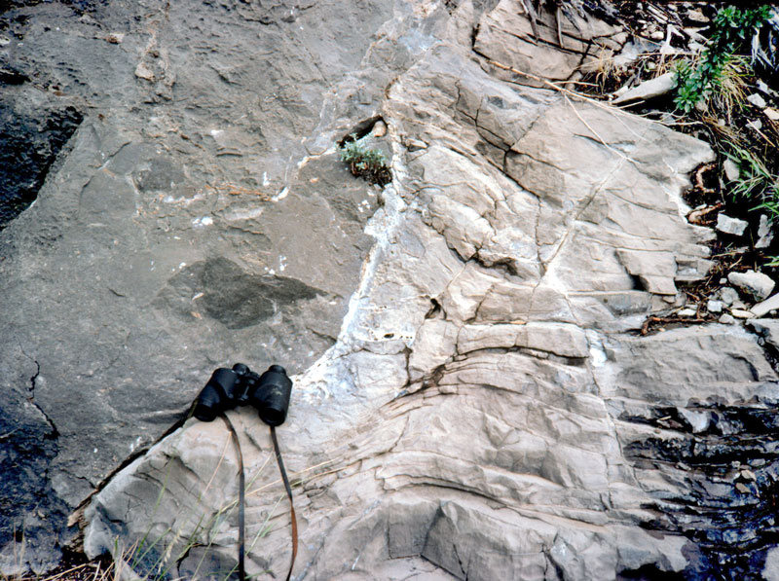
West Face – Channel in Bone Spring
Carbonate Channel
Kendall Photo

Slide 40
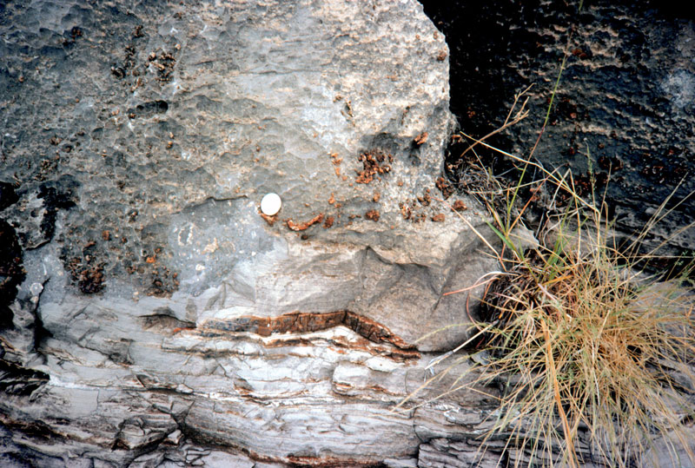
West Face – Channel in Bone Spring
Carbonate Channel
Kendall Photo

Slide 41
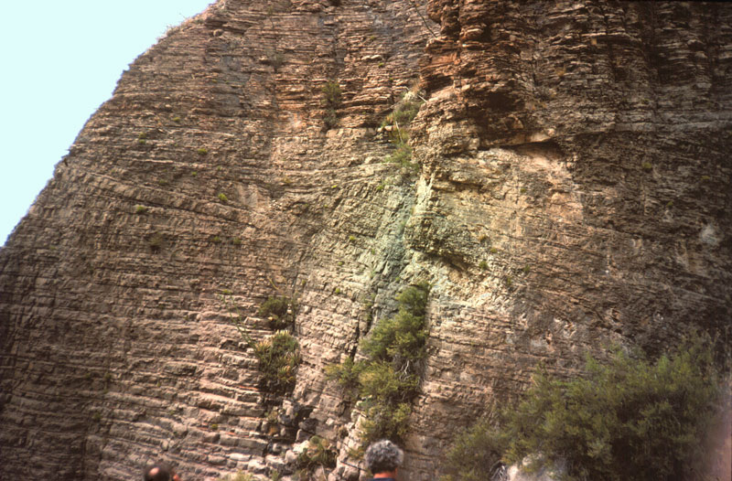
Bone Springs - Cut Off – Contact – Slope Base
Base of Cut Off
Slope Sediments
Kendall Photo

Slide 42
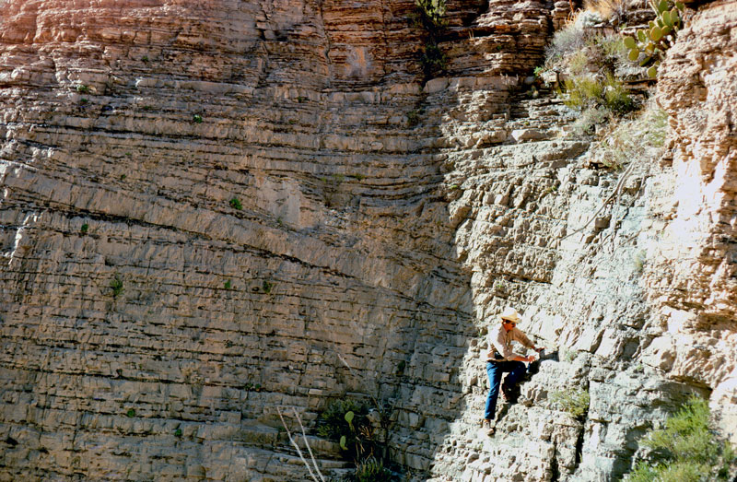
Bone Springs - Cut Off – Contact – Slope Base
Base of Cut Off
Slope Sediments
Kendall Photo

Slide 43
Bone Springs - Cut Off – Contact – Slope Base
Channel cut
Slope Sediments
Kendall Photo

Slide 44
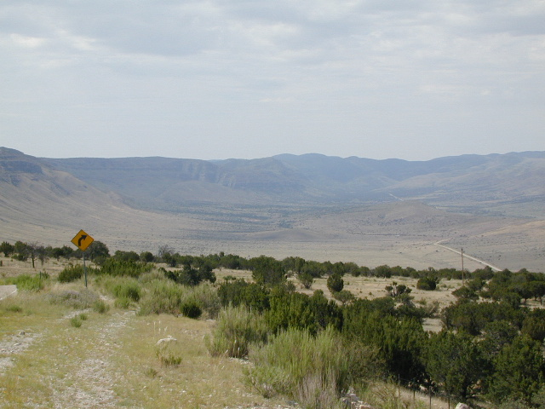
Last Chance Canyon
Kendall Photo

Slide 45
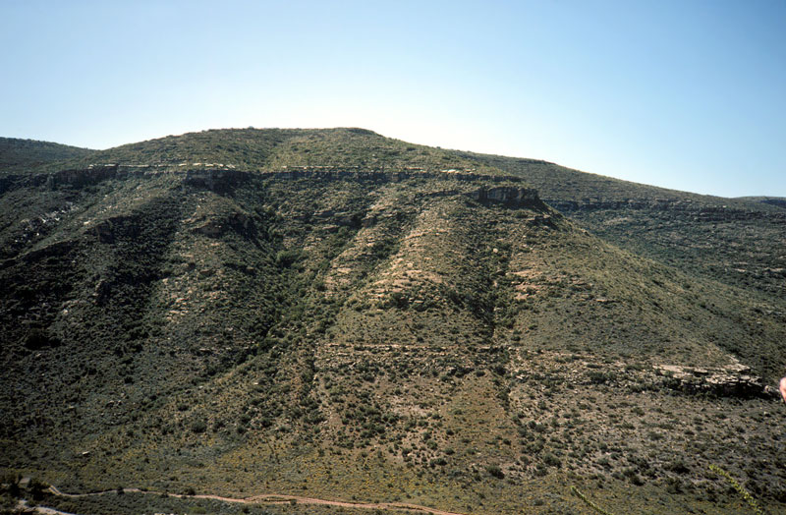
Last Chance Canyon
San Andres Margin
Base of Slope
Kendall Photo

Slide 46
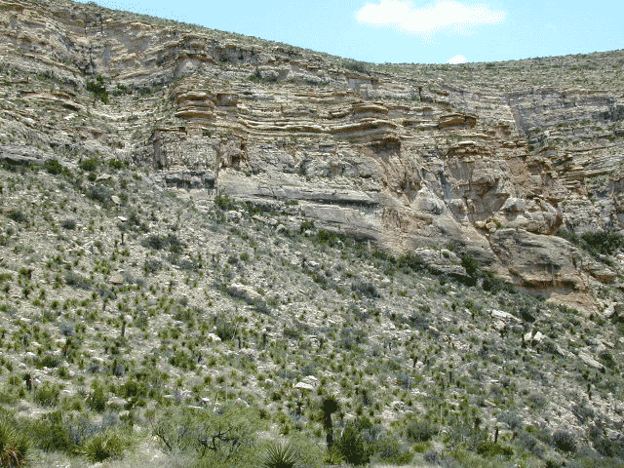
Last Chance Canyon
San Andres Margin
Base of Slope
Kendall Photo

Slide 47
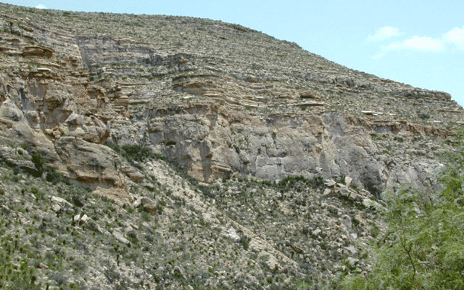
Last Chance Canyon
San Andres Margin
Base of Slope
Kendall Photo

Slide 48
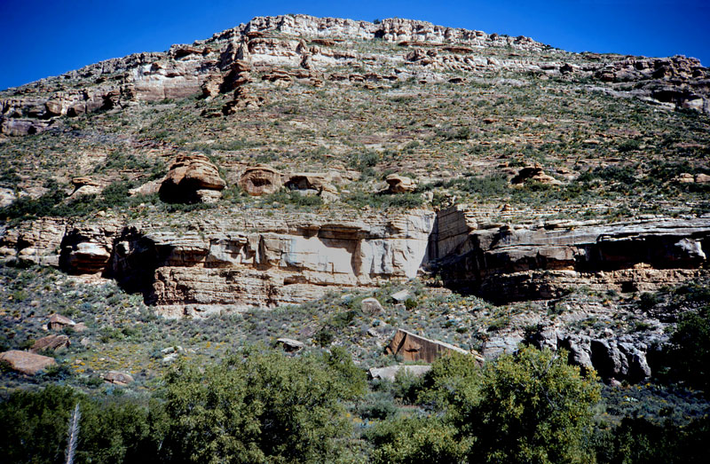
Last Chance Canyon
By pass Turbidite
Kendall Photo

Slide 49
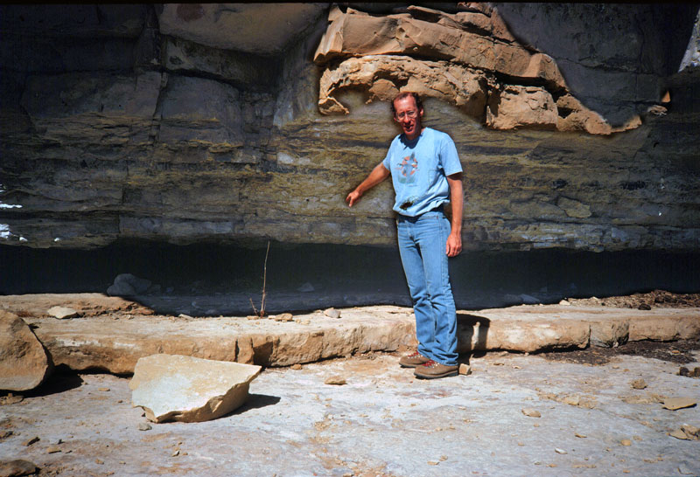
Last Chance Canyon
Downlap Surface
Kendall Photo

Slide 50
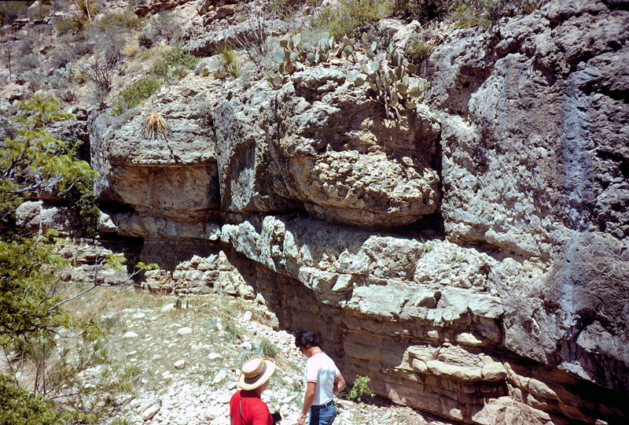
Last Chance Canyon
By pass Turbidite
Kendall Photo

Slide 51
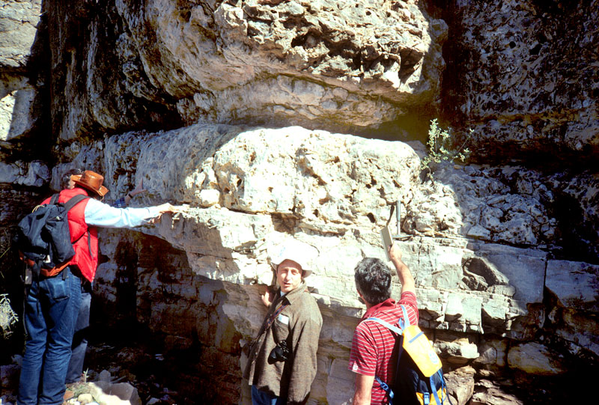
Last Chance Canyon
By pass Turbidite
Kendall Photo

Slide 52
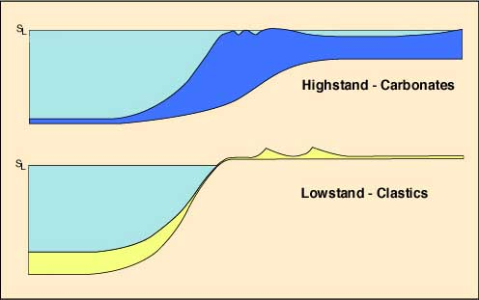
Permian Basin Reciprocal Sedimentation

Slide 53
Permian Basin Margin Exposure at El Capitan
After Tinker 1998

Slide 54
Permian Basin Margin Exposure Clastics

Slide 55
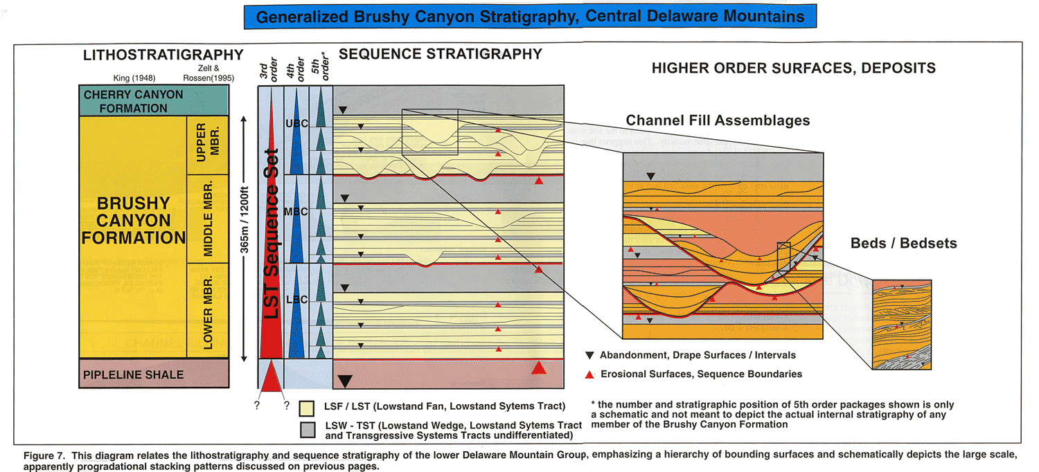
Beaubeouf – His Diagram!
Beaubouef et al, 1999

Slide 56
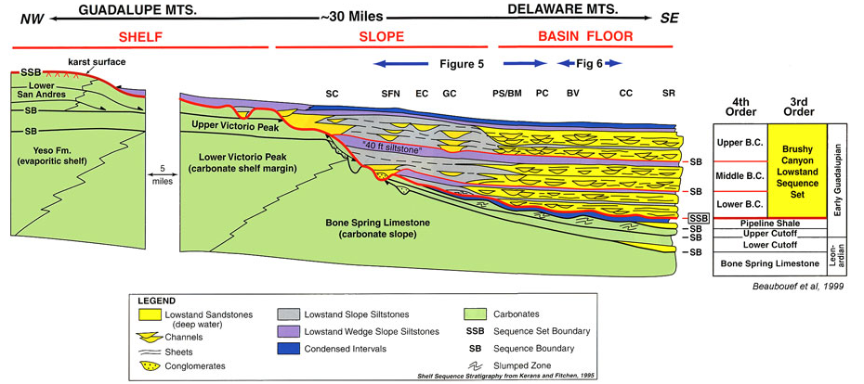
Brushy Canyon Sequence Stratigraphic Frame

Slide 57
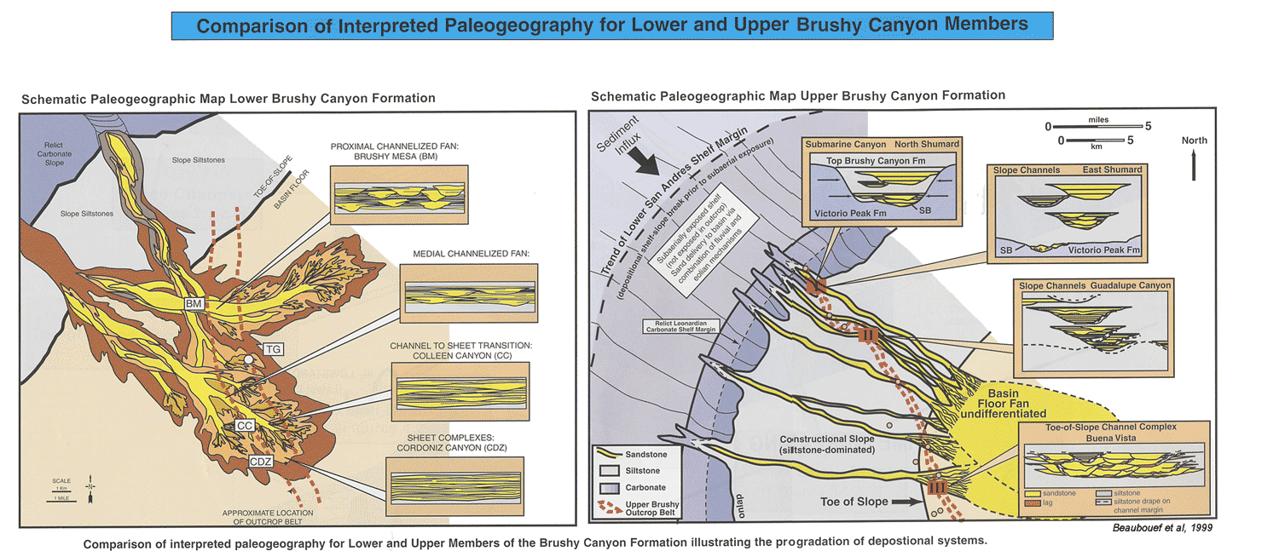
Brushy Canyon Sequence Stratigraphic Frame

Slide 58
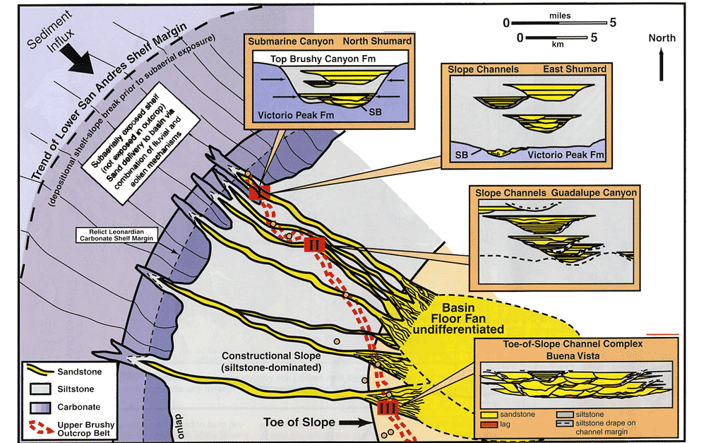
Beaubouef et al, 1999

Slide 59
Three Stage Lowstand of Brushy Canyon Fm

Slide 60
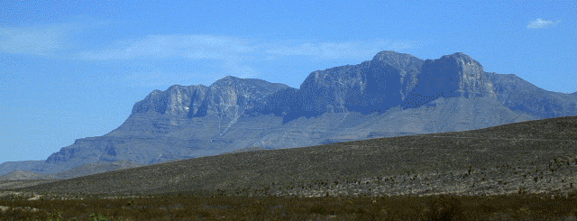
West Face – Margin & Slope Permian Basin
Reef &
Fore Reef
Margin Clastic
Turbidites
Kendall Photo

Slide 61
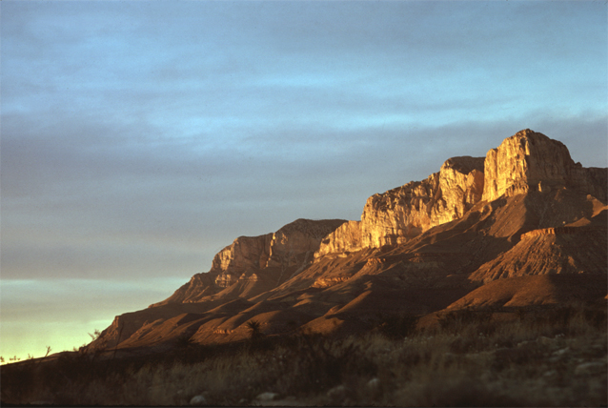
El Capitan & Base of Slope Permian Basin
Reef &
Fore Reef
Margin Clastic
Turbidites
Kendall Photo

Slide 62
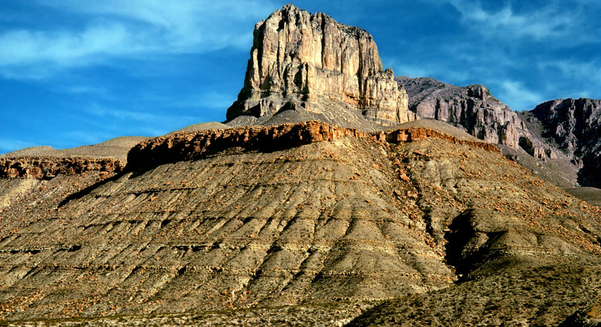
El Capitan & Brushy Canyon Fm Foreground
Reef &
Fore Reef
Margin Clastic
Turbidites
Kendall Photo

Slide 63
Principle Belts of Carbonate Accumulation
SLOPE

Slide 64
Guadalupe Mts – Margin Slope
Fore-slope
Marginal Clastics
Kendall Photo

Slide 65
Delaware Mountains – Basin Fans
Deepwater Channel
Channel Sands
Kendall Photo

Slide 66
Brushy Canyon Group - Base of Slope
Margin Clastic
Turbidites
Kendall Photo

Slide 67
Brushy Canyon Group - Base of Slope
Margin of submarine fan channel incised into "overbank". Channel fill with amalgamation and flowage with injection of sand into surrounding strata of channel walls
Kendall Photo

Slide 68
Brushy Canyon Group - Base of Slope
Margin Clastic
Turbidites
Kendall Photo

Slide 69
Sequence Stratigraphy of Permian Basin

Slide 70
General Stratigraphy of Permian Basin
Scholle, 1999

Slide 71
Base of Slope Depositional Geometries
Kendall Diagram

Slide 72
Cherry Canyon Fm, Base of Slope
Channel Cut
Kendall Photo

Slide 73
Bell Canyon- Mouth of McKitrick Cayon
Bell Canyon Sands
Kendall Photo

Slide 74
Bell Canyon- Mouth of McKitrick Cayon
Bell Canyon Sands
Kendall Photo

Slide 75
Permian Basin – Margin Slope
Scholle 1999

Slide 76
Slope Facies and Geometries
Upslope:
Heterogeneous wackestones to packstones to grainstone & rudstone offbank transport
Lime mudstone-wackestone from fine-grained periplatform shedding & quiescent foreslope
Local presence of well-sorted grain-rich tempestites
Brittle reef failure & debris of breccias and blocks (olistoliths) common
Down slope homogenous dispersed bioclastic packstone to mudstone from upslope, often bioturbated
Fining upward cycles common
Bedding:
Interfingering unconfined aggrading & retrograding foreslope clinoform sheets
Thick upslope/thin downslope
Local confined sheets and channel fill can be common
Fauna high numbers upslope but sparser & restricted downslope
Bioturbation cosmopolitan in shallows protected from heavy wave action; in deeper upper slope burrowing often intense
FSST & lowstand LST erosional surfaces from sediment bypass from upslope, downslope wackestone and packstone from forced regressive shorelines of margin
FSST/LST collapse margin megabreccias as sea-level falls
TST onlapping sheets of open-marine facies of argillaceous lime mudstone & wackestone; local buildups, especially over topographic highs
HST lime mudstone to wackestone sheets from margin, SB erosional to subaerial unconformity caps

Slide 77
Permian Basin Reciprocal Sedimentation
Evolution From Low Slope Ramp To Steep Rim - Basin Starvation In Action
Kendall Diagram

Slide 78
Permian Basin Reciprocal Sedimentation

Slide 79
Guadalupe Shelf – Big Canyon
Capitan Reef
Capitan Reef Slope
Photo Scholle, 1999

Slide 80
Carbonate Margin and Slope Facies

Slide 81
Base of Slope – Permian Basin
Kendall Photo
7 km basinward of shelf margin Bell Canyon Formation sandstones enclose Rader Conglomerate: U.S. Highway 62-180 approx 2 km south of McKittrick Canyon, TX. intersection

Slide 82
Rader Conglomerate – Bell Canyon
Kendall Photo

Slide 83
Rader Conglomerate – Bell Canyon
Kendall Photo

Slide 84
Downslope Carbonate Facies Permian Basin
Rader Turbidite
Cherry Canyon Formation
Kendall Photo

Slide 85
Carbonate Margin and Slope Facies
Kendall Diagram

Slide 86
Carbonate Margin and Slope Facies
Kendall Diagram

Slide 87
Basin Facies & Geometries
Homogenous vertical cycles of mudstone, marl to shale – a response to eustatic changes
Fining upward cycles common
Bedding: unconfined thin widespread sheets
Fauna low numbers & sparse away from margin
Bioturbation common on surfaces where supply rates low
Low LST and TST (& early HST) platform rapid aggradation & slope supply debris & mud flows
HST platform derived grain-flow, density-flow & turbidite sands & less lime mud. Lower slope thinning-thickening upward calciturbidites metre-scale & upwards beds, formed from millennial eustatic or climatic change

Slide 88
Base of Slope – Lamar Lst - Permian Basin
Kendall Photo

Slide 89
Base of Slope – Lamar Lst - Permian Basin
Scholle, 1999

Slide 90
Basin Barred So Only Net Inflow of Sea

Slide 91
Permian Basin - Castille Fm. – New Mexico
El Capitan Peak
Basinal
Gypsum
Kendall Photo

Slide 92
Permian Basin - Castille Fm. – New Mexico
Light layers
are
Gypsum
Dark layers
are
Dolomite
Kendall Photo

Slide 93
Permian Basin - Castille Fm. – New Mexico
Crenulated
Light Layers
are Gypsum
after Anhydrite
Dark layers
are
Dolomite
Kendall Photo

Slide 94
Permian Basin – Genealized Section – New Mx
Permian Basin Fill

Slide 95
Guadalupe Mtns - West Face
Reef &
Fore Reef
Basinal Clastic
Turbidites
Kendall Photo

Slide 96
West Face – Margin of Permian Basin
Kendall Photo

Slide 97
Guadalupe Margin – South of Pine Spring
Capitan Reef
Delaware Mt Group Slope
Kendall Photo

Slide 98
Guadalupe Shelf – Big Canyon
Capitan Reef
Capitan Reef Slope
Photo Scholle, 1999

Slide 99
Guadalupe Shelf – Big Canyon
Back Reef Tansill Cycles
Massive Capitan Reef
Kendall Photo

Slide 100
Guadalupe Slope – Mouth of McKitrick Canyon
Massive Capitan Reef
Capitan Reef Slope
Kendall Photo

Slide 101
Guadalupe Slope – Mouth of McKitrick Canyon
Capitan Reef Slope
Kendall Photo

Slide 102
Guadalupe Slope – Mouth of McKitrick Canyon
Capitan Reef Slope
Bioherm or Reef Debris
Kendall Photo

Slide 103
Carbonate Margin and Slope Facies

Slide 104
Carbonate Depositional Settings
Shelf
Outer more normal marine
Inner restricted
Shelf margin crest
Margin slope
Basin

Slide 105
Basin and Lower Slope Facies

Slide 106
Principle Belts of Carbonate Accumulation
MARGIN

Slide 107
Margin Crest Facies & Geometries
Sediments heterogeneous to homogenous bioclastic packstone to grainstone
Shoaling upward cycles common
Bedding:
Unconfined thick to massive homogeneous sheets to linear bodies parallel (barrier shoals) &
Perpendicular (tidal channels) to margin
Fauna high numbers & cosmopolitan
Downslope ecological accommodation common with massive boundstones and heterogeneous open-marine ‘reef-building’ skeletal materials often grain-prone in distal portions; upper bounding surfaces often
SB & less visible mfs
FSST & LST include exposure surfaces, or, if sea-level fall less, forced regressions of packstone and wackestone facies of shoreline bodies of upper slope area (perched parasequences) parallel to margin
TST onlapping sheets of open-marine facies of mudstones, wackestones & packstone sheets
HST base of finer lime mudstones & wackestones, & overlain by aggrading shoaling-up cycles of grainstone ribbons parallel to the platform margin and massive merging boundstone parallel to margin capped by subaerial SB

Slide 108
Depositional Settings of Permian Basin
Open
Shelf
Sabkha
Sediments
Basin
Margin
Carbonates
Basinal
Clastics
Kendall Photo

Slide 109
Depositional Settings of Permian Basin

Slide 110
Depositional Settings of Permian Basin
Open Marine Shelf
Restricted
Tidal Flats
& Lagoon
Margin
Slope
Basin
Fill

Slide 111
Depositional Settings of Permian Basin
Scholle, 1999; after Babcock

Slide 112
Guadalupe Shelf – Slaughter Canyon
Back Reef Cycles
Massive Capitan Reef
Kendall Photo

Slide 113
Peter Scholle’s – Over Simple Diagram!
Peter Scholle

Slide 114
Capitan Reef Facies – Walnut Canyon
Sponges
Archeolithoporella
Photo Scholle, 1999

Slide 115
Capitan Reef Facies – Walnut Canyon
Archeolithoporella
Neptunian
Dike
Photo Scholle, 1999

Slide 116
Capitan Reef Facies – Walnut Canyon
Archaeolithoporella
Coating Sponges
Sponges
Archeolithoporella
Kendall Photo

Slide 117
Capitan Reef Facies – Archaeolithoporella
Marine Aragonite replaced by Calcite
Kendall Photo

Slide 118
Capitan Reef Facies – Walnut Canyon
Marine Aragonite replaced by Calcite
Kendall Photo

Slide 119
Capitan Reef Facies – Walnut Canyon
Babcock

Slide 120
Capitan Reef Facies – Walnut Canyon
Babcock

Slide 121
Capitan Reef Facies – Walnut Canyon
Babcock

Slide 122
Guadalupe Mountains – Capitan Limestone
Massive Capitan Reef Fabric
Kendall Photo

Slide 123
Guadalupe Shelf – Slaughter Canyon
Sheets of
Carbonate Grains
of Outer Shelf
Back Reef Cycles
Massive Capitan Reef
Kendall Photo

Slide 124
Guadalupe Shelf – Slaughter Canyon
Cross
Bedded
Beach
Sediments
Seven Rivers Fm
-
Slaughter Canyon
–
W. Texas
Shoaling
Cycle
Kendall Photo

Slide 125
Tansill Fm – Walnut Canyon – N.Mx
Cross
Bedded
Beach
Sediments
Kendall Photo

Slide 126
Seven Rivers Fm. – Slaughter Canyon
Mizzia &
Grapestones
Kendall Photo

Slide 127
Tansill Fm - Dark Canyon
Green Calc Algae - Mizzia
Kendall Photo

Slide 128
Tansill Fm – Walnut Canyon – New Mexico
Cross
Bedded
Beach
Sediments
Kendall Photo

Slide 129
Tansill Fm - Dark Canyon
Ghosts of
Mizzia &
Ooids
Kendall Photo

Slide 130
Tansill Fm - Dark Canyon
Pisolites &
Fenestral
Tidal Flats
Kendall Photo

Slide 131
Tansill Fm - Dark Canyon
Algal
Stromatolite
Heads
Kendall Photo

Slide 132
Tansill Fm - Dark Canyon
Tidal Flat
Algal
Stromatolite
Laminae
Kendall Photo

Slide 133
Tansill Fm - Dark Canyon
Mizzia
Hash
Beach
Sediments
Kendall Photo

Slide 134
Tansill Fm - Dark Canyon
Tidal Flat
Mud Cracked
Storm
Laminae
Kendall Photo

Slide 135
Walnut Canyon – Tepees
Pisolitic
Fenstrated
Lst Blocks
& Travertine
Cements
Kendall Photo

Slide 136
Walnut Canyon – Tepees at the Cavern
Pisolitic
Fenstrated
Lst Blocks
& Travertine
Cements
Kendall Photo

Slide 137
Yates Fm – Dark Canyon - New Mexico
Megapolygon Saucers with
Upturned Margins
Tepee
Axies
Tepee
Axies
Tepee
Axies
Tepee
Axies
Vertical Cycles
of Supratidal
Pisolitic
Fenestral Lst
Aeolian Silt
C. G. St. C. Kendall Photo, 1967

Slide 138
Tansill Fm – Walnut Canyon – N.Mx

Slide 139
Yates Fm - Walnut Canyon - New Mexico
Pisolitic
Fenstrated
Lst Blocks
& Travertine
Cements
Aeolian Silt
Kendall Photo

Slide 140
Yates Fm - Walnut Canyon - New Mexico
Megapolygon Saucers with
Upturned Margins
Tepee
Axies
Tepee
Axies
Vertical Cycles
of Supratidal
Pisolitic
Fenestral Lst
Aeolian Silt
Kendall Photo

Slide 141
Yates Fm – Dark Canyon - New Mexico
Pisolitic
Fenstrated
Lst Blocks
& Aeolian
Silt Fill
Kendall Photo

Slide 142
Yates Fm – Dark Canyon - New Mexico
Pisolitic
Fenstrated
Lst Blocks
& Aeolian
Silt Fill
Kendall Photo

Slide 143
Yates Fm – Walnut Canyon - New Mexico
Pisolitic
Fenstrated
Lst Blocks
& Travertine
Cements
Kendall Photo

Slide 144
Yates Fm – Walnut Canyon - New Mexico
Pisolitic
Fenstrated
Lst Blocks
Kendall Photo

Slide 145
Yates Fm – Walnut Canyon - New Mexico
Pisolitic
Fenstrated
Lst Blocks in
Travertine
Cement
Internal Marine sediment
Kendall Photo

Slide 146
Yates Fm – Walnut Canyon - New Mexico
Kendall Photo

Slide 147
Yates Fm – Walnut Canyon - New Mexico
Pisolitic
Fenstrated
Lst Blocks in
Travertine
Cement
Internal Marine sediment
Kendall Photo

Slide 148
Yates Fm – Dark Canyon - New Mexico
Pisolitic
Fenstrated
Lst Blocks in
Travertine
Cement
Kendall Photo

Slide 149
Carlsbad Group - New Mexico
Folk & Louck’s
Aragonite replaced by Calcite
-
NW Shelf

Slide 150
Tepee Form in Carlsbad Group - Permian

Slide 151
Coastal Bay – J. Dhanna - UAE

Slide 152
Coastal Bay – J. Dhanna - UAE
Marine Travertine
Purser & Loreau Photo

Slide 153
Coastal Bay – J. Dhanna - UAE
Supratidal Crust
Purser & Loreau Photo

Slide 154
Tidal Flat Mud Flakes

Slide 155
Tidal Flat Cyanobacterial Mats – Rocky Arroyo
Cyanobacterial Mats
Kendall Photo

Slide 156
Tidal Flat Cyanobacterial Mats – Rocky Arroyo
Cyanobacterial Mats
Micrite Storm Lamina
Kendall Photo

Slide 157
Carbonate Shelf - Gas Escape - Seven Rivers Fm - New Mexico
Tidal Flat Cyanobacterial Mats – Rocky Arroyo
After James
Kendall Photo

Slide 158
McElroy Field Greyburg/San Andres
Dolomite
Gypsum
Scholle. 1999

Slide 159
Tidal Flat Cyanobacterial Mats – Dark Canyon
Intraclast
Cyanobacterial Mat
Kendall Photo

Slide 160
Seven Rivers Fm – New Mexico
Dolomite
Sabkha
Cycle
Gypsum
Sabkha
Cycle
Quartz Silt
Kendall Photo

Slide 161
Seven Rivers Fm – New Mexico
Sabkha
Cycle
Upper Tidal
Flat Dolomite
Sabkha of the “Guadalupian” Permian Seven Rivers Formation, of the Seven Rivers Embayment, New Mexico.
Supratidal
Gypsum
Sabkha
Cycle
Windblown
& Fluvial Silts
Kendall Photo

Slide 162
Seven Rivers Fm – New Mexico
Upper Tidal
Flat Dolomite
Sabkha
Cycle
Supratidal
Dolomite
Sabkha
Cycle
Collapse Breccia
& Aeolian Silts
Sabkha of the “Guadalupian” Permian Seven Rivers Formation, Dark Canyon, New Mexico.
Kendall Photo

Slide 163
Western Coast UAE- Parasequences
Sabkha
Cycle

Slide 164
Depositional Systems of Permian Basin

Slide 165
Seven Rivers Formation, New Mexico
Quartz Silt
Gypsum
Dolomite

Slide 166
Seven Rivers Formation, New Mexico
Shoaling
Upward
Salt Flat
Cycles
Quartz Silt
Gypsum
Dolomite
Photo Scholle, 1999

Slide 167
Seven Rivers Formation, New Mexico
Sequence
Boundary
Quartz Silt
Sabkha
Cycle
Gypsum
Dolomite
Transgressive
Surface
Kendall Photo

Slide 168
Seven Rivers Formation, New Mexico

Slide 169
Seven Rivers Formation, New Mexico
Upper Tidal
Flat Dolomite
Sabkha
Cycle
Sabkha
Cycle
Sabkha
Cycle
Collapse Breccia
& Aeolian Silts
Sabkha of the “Guadalupian” Permian Seven Rivers Formation, Rocky Arroyo New Mexico.
Kendall Photo

Slide 170
Seven Rivers Fm – New Mexico
Collapse Breccia
in Aeolian Silts
Quartz Silt
Kendall Photo

Slide 171
Restricted Playas & Basin Evaporites
Match sea level of Lowstand and Transgressive System Tract
Matrix poor
Deeper parts of the isolated evaporite basin
Extensive bodies
Thin interbedded fabric reflects seasonal evaporative cycles of circum basin climate

Slide 172
Lecture Conclusions
Shelf has wide spread continuous sheets that tend to shoal up
Outer shelf:- heterogeneous carbonates with mix of linear bodies parallel to basin & perpendicular to it! Local build up lenses.
Inner shelf:- dominated by mud prone sheets with evaporites & or clastic channels and sheets
Margin: Massive and heterogeneous, most porous but least prone to seal
Down slope sheets that thin down slope & may be grain prone in distal portions
Basinal couplets of mud and silt from mix of pelagic and shelf sources
Evaporite couplet from basin isolation

Slide 173
Principle Belts of Carbonate Accumulation
MARGIN
RESTRICTED
OPEN MARINE
SHELF
SLOPE
BASIN

Slide 174
Depositional Settings of Permian Basin
Open Marine Shelf
Restricted
Tidal Flats
& Lagoon
Margin
Slope
Basin
Fill

Slide 175
Geological Map of Permian Basin
Scholle, 1999

Slide 176
Stratigraphic Nomenclature of Permian Basin
Scholle, 1999

Slide 177
Permian Basin Settings and Oil Fields

Slide 178
Permian Basin Settings and Oil Fields

Slide 179
Permian Basin Settings and Oil Fields

Slide 180
Permian Basin Settings and Oil Fields

Slide 181
Permian Basin Settings and Oil Fields

Slide 182
Permian Basin Settings and Oil Fields

Slide 183
Permian Basin Settings and Oil Fields

Slide 184
Permian Basin Seismic Cross Section
Capitan Reef
Goat Seep Reef

Slide 185
Cross Section of Central Basin Platform
Scholle after Ward et al, 1983

Slide 186
Cross Section of SW-NE Garza County, Tx

Slide 187
Cross Section of SW-NE Garza County, Tx

Slide 188
Slaughter and Levelland Fields, Texas

Slide 189
Slaughter and Levelland Fields, Texas

Slide 190
Hendrick Field – Winkler County, Texas

Slide 191
Hendrick Field – Winkler County, Texas

Slide 192
Foster-South Cowden Field – Ector County

Slide 193
McElroy Field –Texas

Slide 194
Permian Basin – Correlation Chart

Slide 195
Permian Basin – Correlation Chart

Slide 196
Permian Basin – Seismic Cross Section

Slide 197
Setting | Inner Shelf | Outer Shelf | Margin | Slope | Basin
Facies | Sediment homogeneous – Muds, pellets to bioclastic packstone to wackestone; local evaporites Shoaling upward cycles common, predictable & correlatable finer carbonate capped by tidal-flat dominated by cyanobacteria &/or evaporites | Sediment heterogeneous: ooids, grapestones & hardened pellets to bioclastic grain shoals to patch reef & shoal build ups Shoaling upward cycles common, predictable and correlatable | Sediments heterogeneous to homogenous bioclastic packstone to grainstone accumulations Shoaling upward cycles common | Upslope: Heterogeneous wackestones to packstones to grainstone & rudstone offbank transport Lime mudstone-wackestone from fine-grained periplatform shedding & quiescent foreslope Local presence of well-sorted grain-rich tempestites Brittle reef failure & debris of breccias and blocks (olistoliths) common Down slope homogenous dispersed bioclastic packstone to mudstone from upslope, often bioturbated Fining upward cycles common | Homogenous vertical cycles of mudstone, marl to shale, from eustatic changes Fining upward cycles common
Geometry | Unconfined sheets of homogeneous sediment Local storm driven confined channel fill | Unconfined heterogeneous sediment sheets Local confined channel fill Local confined lens shaped build ups | Unconfined thick to massive homogeneous sheets to linear bodies parallel (barrier shoals) perpendicular (tidal channels) to margin | Interfingering unconfined aggrade & retrograde of foreslope clinoform sheets; thick upslope/thin downslope Local confined sheets and channel fill can be common | unconfined thin widespread sheets
Fauna | Fauna often high numbers & restricted | Fauna commonly shallow water, heterogeneous and moderately cosmopolitan | Fauna high numbers & cosmopolitan Downslope ecological accommodation common with massive boundstones & heterogeneous open-marine ‘reef-building’ skeletal materials often grain-prone in distal portions; upper bounding surfaces often SB & less visible mfs | Fauna high numbers upslope but sparser & restricted downslope Bioturbation cosmopolitan in shallows protected from heavy wave action; in deeper upper slope burrowing often intense | Fauna low numbers & sparse away from margin Bioturbation common on surfaces with low supply rates
LST | FSST & subsequent LST exposure SBs, potential karstification &/or no accumulation | FSST and LST common exposure surfaces & discontinuous mudstone to wackestone fill of incised tidal channels perpendicular to margin overlain by discontinuous to continuous microbial flat sheets | FSST & LST include exposure surfaces, or, where sea-level fall less, forced regressions of packstone and wackestone facies of shoreline bodies of upper slope area (perched parasequences) parallel to margin | FSST & lowstand LST erosional surfaces from sediment bypass from upslope, downslope from forced regressive shorelines with wackestone and packstone facies extending downslope from the basin margin FSST/LST collapse margin megabreccias at sea-level falls | LST and TST (& early HST) when platforms aggrade rapidly they & slope supply debris & mud flows
TST | TST often missing or reworked earlier sediments | TST onlapping linear sheets parallel to margin with local aggradation of TST lenses | TST onlapping sheets of open-marine facies of mudstones, wackestones & packstone sheets | TST onlapping sheets of open-marine facies of argillaceous lime mudstone and wackestone; local buildups, especially over topographic highs | LST and TST (& early HST) when platforms aggrade rapidly they & slope supply debris & mud flows
HST | HST base of organic-rich argillaceous carbonate or shale | HST elevated aggradational, linear, ribbons of lime-sand barriers and shoals parallel to margin capped by subaerial SBs | HST base of finer lime mudstones & wackestones, & overlain by aggrading shoaling-up cycles of grainstone ribbons parallel to the platform margin & massive merging boundstone parallel to margin capped by subaerial SB | HST lime mudstone to wackestone sheets from margin, SB erosional to subaerial unconformity caps | HST platform shedding, grain-flow, density-flow & turbidite sands & less lime mud. Lower slope thinning-thickening upward calciturbidites metre-scale & upwards beds, product of millennial eustatic or climatic change

Slide 198
Lecture Conclusions
Shelf has wide spread continuous sheets that tend to shoal up
Outer shelf:- heterogeneous carbonates with mix of linear bodies parallel to basin & perpendicular to it! Local build up lenses.
Inner shelf:- dominated by mud prone sheets with evaporites & or clastic channels and sheets
Margin: Massive and heterogeneous, most porous but least prone to seal
Down slope sheets that thin down slope & may be grain prone in distal portions
Basinal couplets of mud and shale from mix of pelagic and shelf sources.

Slide 199
Major Evaporite Settings
Basin-Center Evaporites
Platform Evaporites
Continental
Evaporites
Shallow to
Deep Basin
Subaqueous Evaporative Lagoon
Sabkha, Salina,
Mudflat
Mean Sea Level
Basin-Center (Commonly product of LST & TST)
Thick evaporites deposited across whole basin (> 50 m thick evaporite intervals)
Shallow to deep water evaporites occur in many different settings (shelf, slope, basin)
Platform (Commonly product of LST & TST)
< 50 m thick evaporite intervals, commonly < 5 m thick evaporite beds inter-bedded with thin to thick carbonate intervals
Shallow water (Evaporitive Lagoon) & subaerial (Sabkha, Salina, Mudflat) evaporites landward of barrier or sill
Open marine sediments deposited seaward of sill
Continental (Playa Lakes) (not discussed here)
Discovered Reserves for Proven Carbonate Plays
Total = 490,000 MBOE
Discovered Reserves for Proven Evaporite Plays
Total = 485,884 MBOE
52%
48%
Basin
Center
Platform

Slide 200
Lecture Ends!!
and so for a glass of lemonade!

